Slide 1
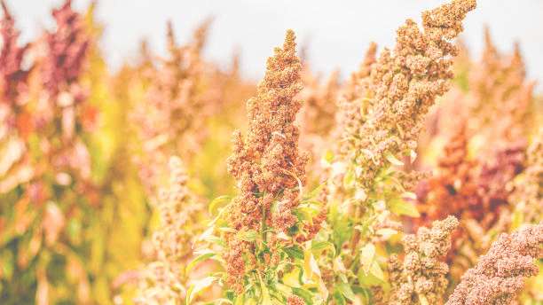
V International Conference la ValSe-Food
& VIII Symposium Chia-Link
Feeding biodiversity and mitigating the effects of climate change:
the role of ancestral crops in creating healthy food

Slide 2
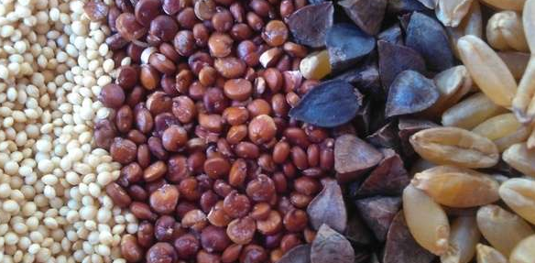
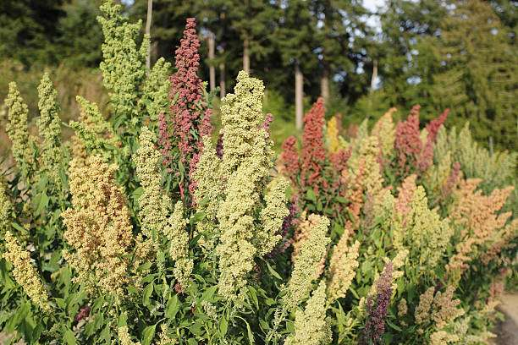
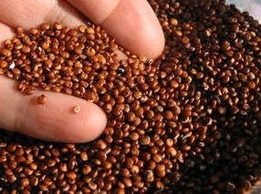
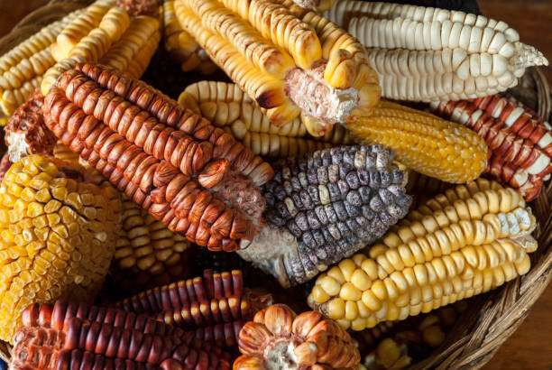
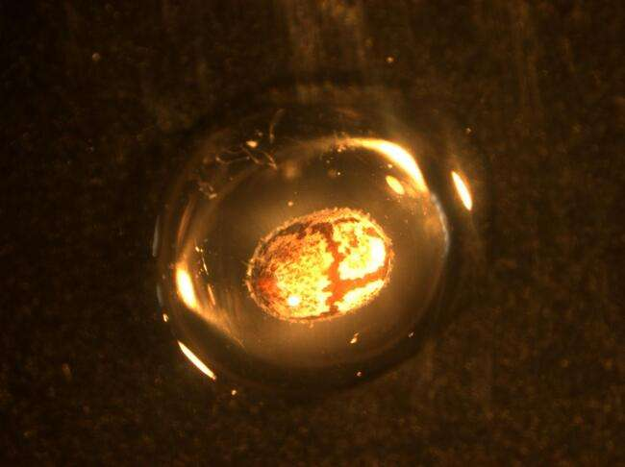
ValSe23
Sustantivo | affiliation
Title
institutional logo
Name
Afiliación

Slide 3
Instructions
Conference Title
Title of the presentation + name and surname + Affiliation (1 slide)+ institutional logo
Content of the presentation (The number of slides should be adjusted to the time allotted)
Acknowledgements
Duration of the presentations 30 min (25 min + 5 min for questions), with the exception of Keynote 1 h (50 min + 10 min for questions).
The official spoken language is English, Spanish or Portuguese
and the official written language is English

Slide 4
Text – Tables – Figures - Graphics
Premium
Estándar
Básico
Modalidad 1
Text in English

Slide 5
ValSe23
Acknowledgments

Slide 6
THANK YOU

